Slide 1
Partitioned Logistic Regression for Spam Filtering
Ming-wei Chang
University of Illinois at Urbana-Champaign
Wen-tau Yih and Christopher Meek
Microsoft Research
The work was done while the first author was an intern at MSR

Slide 2
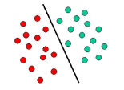
Linear Classifiers
Linear classifiers are used in many applications
Document classification, information extraction tasks, spam filtering …
Why? Good performance in high dimensional spaces
Very Efficient
Two popular algorithms
Naïve Bayes (NB) and Logistic Regression (LR)
NB: conditional independence assumption
LR: can capture the dependence between features

Slide 3
Our Contributions
We propose partitioned logistic regression (PLR)
A new hybrid model of NB and LR
A weaker conditional independence assumption
Suitable for tasks with “natural feature groups”
It works great on spam filtering!
It improves the AUC_{fpr<=10%} by 28.8% and 23.6% compared to NB and LR, respectively
Easy to implement and use

Slide 4
Outline
Introduction
The Model: Partitioned Logistic Regression
Analysis of Partitioned Logistic Regression
Application to Spam Filtering
Conclusion

Slide 5
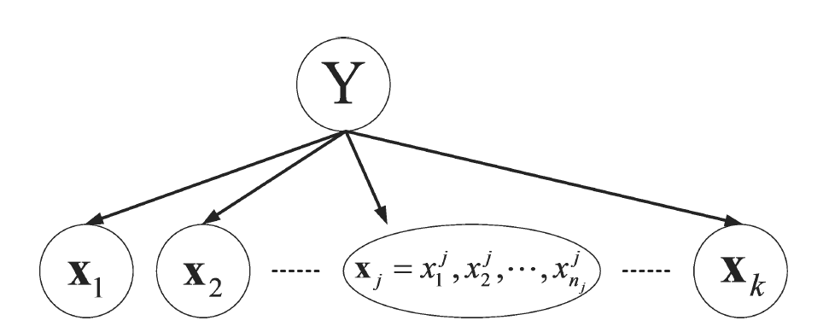
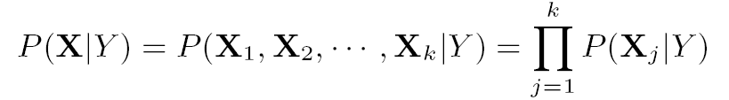
Partitioned Logistic Regression
Key Assumption: each feature group is conditionally independent of each other given the label
Feature Groups

Slide 6
Feature Groups
Only one feature per group: Naïve Bayes
Only one feature group: Logistic Regression
How to decide feature groups?
Some applications have natural feature groups
Spam Filtering: User, Sender, Content
Document Classification: Title, Content
Webpage Classification: Content and hyperlink

Slide 7
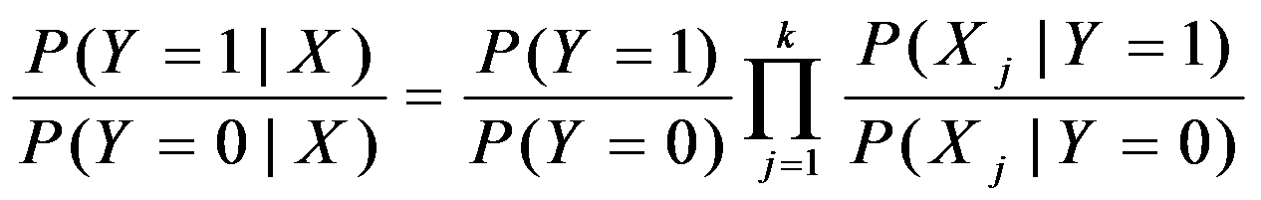
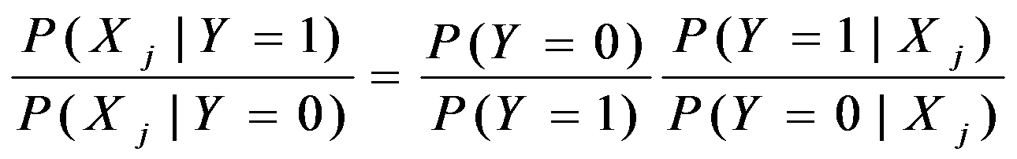
Training and Testing PLR
Prediction: Combine sub-models (NB Principle)
Class Distribution
Probability From LR

Slide 8
Outline
Introduction
The Model: Partitioned Logistic Regression
Analysis of Partitioned Logistic Regression
Application to Spam Filtering
Conclusion

Slide 9
Generative vs. Discriminative
Generative (NB) V.S. Discriminative (LR)
Small number of labeled instances, NB can be etter !
[Ng and Jordan 2002]
Asymptotic Error (with enough examples)
Err(LR) ≤ Err(NB)
Number of training examples required to converge
#Example(NB) ≤ #Example(LR)
Trade off between
Approximation Error + Estimation Error
NB might have a higher approximation error
But might have a lower estimation error

Slide 10
PLR: A Hybrid Model
Asymptotic Error (with enough examples)
Err(LR ) ≤ Err(PLR) ≤ Err(NB)
Number of training examples required to converge
#Example(NB) ≤ #Example(PLR) ≤ #Example(LR)
Therefore, which algorithm is preferred?
Depends on the task and the amount of training data
In practice, PLR often outperforms LR and NB
If we have good feature groups

Slide 11
Experiments on Synthetic Dataset
Draw artificial data from Gaussian distributions
Control the co-variance of two feature groups
When feature groups are conditionally independent,
PLR is better than LR!
When feature groups are not conditionally independent
Small amount of labeled data, PLR is still better
Large amount of labeled data, LR is better

Slide 12
Outline
Introduction
The Model: Partitioned Logistic Regression
Analysis of Partitioned Logistic Regression
Application to Spam Filtering
Conclusion

Slide 13
Fighting Spam with PLR
Spam filtering: just a text classification problem? NO!
Relying on only email content is vulnerable
[Lowd and Meek 2005]
Need other types of information
User information (Personalized Spam Filtering)
Sender information (Reputation)
Natural Feature Groups !
Adding all information into a single LR
limited improvement (AUC_{fpr<=10%} 0.512 (content)-> 0.521 (all))
Our Solution : Partitioned Logistic Regression
Three feature groups: User, Sender and content

Slide 14
Experimental Setting
Algorithms: NB, LR, PLR
All use the same features, labeled data
The smoothing parameter is selected using development set
Evaluation: ROC Curves
Dataset
Hotmail Feedback Loop (Content, Sender, Receiver)
Train: July t0 Nov, 2005, Test: Dec 2005
TREC 05 & 06 (Content, Sender)

Slide 15
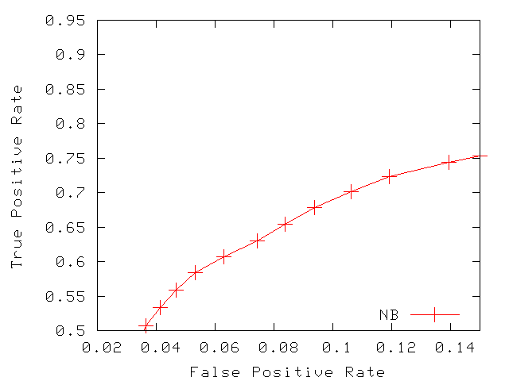
ROC Curves (Hotmail)
Larger AUC = Better

Slide 16
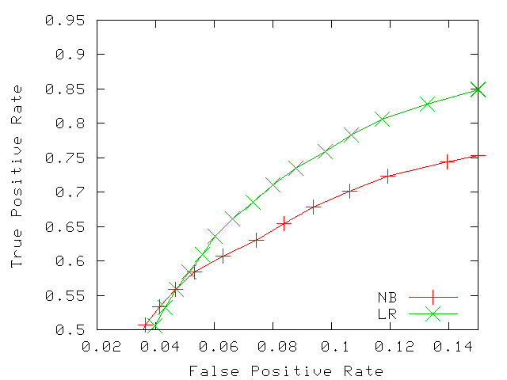
ROC Curves (Hotmail)

Slide 17
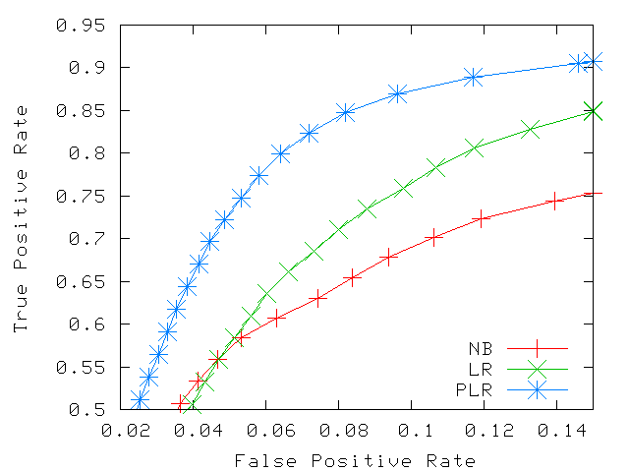
ROC Curves (Hotmail)

Slide 18
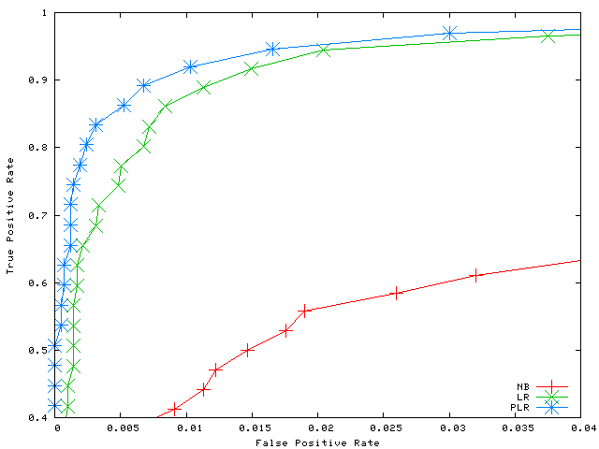
ROC Curves (TREC 06)

Slide 19
Related Works
Product of Experts [Hinton 1999]
Logarithmic opinion pool [Kahn et. al. 1998] [ Smith et. al. 2005]
Alternative NB/LR mixture model
Learn a LR on top of NB [Rania et al. 2004]
Model Combination [Bennett 2006]
The view of conditional independence assumption is novel
Demonstrate the effectiveness of PLR in spam filtering

Slide 20
Conclusion
Machine learning perspective
A novel mixture of discriminative and generative models
Suitable for the applications with “natural feature groups”
Spam Filtering
PLR integrates various information sources nicely
Significantly better than LR and NB
Future Works
Detecting good feature groups automatically
Different methods of combining sub-models

